Slide 1
AllAbroad: Holiday Planner
GitHub
Link to Video Demo

Slide 2
Intro
AllAbroad is a mobile app designed for young travellers and students who struggle deciding where to travel. Rather than searching through countless destinations, accounting for climate, pricing or activities, users answer a few preference-based questions and receive a randomly generated city recommendation tailored to their interests. AllAbroad aims to reduce decision fatigue and encourage spontaneity by helping users discover locations they wouldn't have initially considered.
On top of being a destination discovery tool, AllAbroad functions as a lightweight travel-planning app. Users can save their recommended trips, create itineraries, and access travel information, all within a single app. Through combining the destination discovery with trip management features, the app aims to provide a streamlined and more accessible experience to travel-planning and travelling in general.
The app was inspired by travel applications such as Wanderlog and Polarsteps, both of which provide a user-friendly interface whilst also providing valuable travel planning functionality.

Slide 3
Research

Slide 4
Community
The primary target audience for AllAbroad is young travellers, university students, and first-time independent travellers aged 18-30. This demographic is very much engaged with digital technology and use mobile applications frequently to organise and manage travel experiences.
Young travellers are increasingly choosing to travel independently, but often rely on multiple, separated platforms for itinerary planning, travelling information and booking management. This can be quite time-consuming and overwhelming, especially when choosing somewhere to go on holiday.
Research has identified several challenges faced by the target audience:
Managing travel plans across multiple websites
Spending significant time comparing travel destinations and options
Experiencing decision fatigue when selecting a destination
Finding travel experiences whilst on a budget
Discovering new locations outside of their usual travel preference

Slide 5
Competitor Research
Competitors | Wanderlog | TripIt | Booking.com | Polarsteps
Pros | Great inventory management | Organises travel confirmations | Huge travel database | Travel inspiration/community
Cons | Can feel cluttered at times No search Feature | Weak destination discovery | Overwhelming UI | Less planning focused

Slide 6
Personas
Name | Tia | Daniel | Leah
Age | 21 | 19 | 23
Occupation | University Student | Junior Designer | Influencer
Goals | Find affordable destinations quickly Travel during breaks Avoid spending hours researching | Organise trips easily Save locations and plans Reduce planning stress | Cheap city breaks Maximise Experiences Stay within budget
Frustrations | Too many travel options Doesn’t know where to start Uses multiple apps | Planning feels exhausting Constant tab switching Difficult itinerary organisation | Hidden costs Expensive destinations Too much research required

Slide 7
Initial Feature List
Must Have Features | Possible Implementations | Future Features
Location Questionnaire Random city generator Loading Screen Destination Card Save Trip to “Saved Trips” section Saved trips itinerary Ability to Store Tickets Display destination currency Emergency contacts section Offline maps | AI Suggestions Hotel/Flight Suggestions Nearby Activities Packing Lists | Group Travelling Shared Itineraries Real booking integration AI Travel Assistant

Slide 8
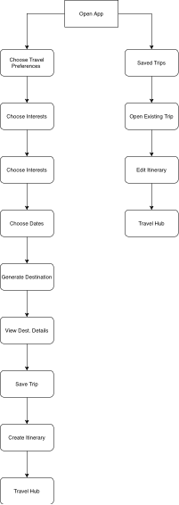
User Flow

Slide 9
Design Direction

Slide 10
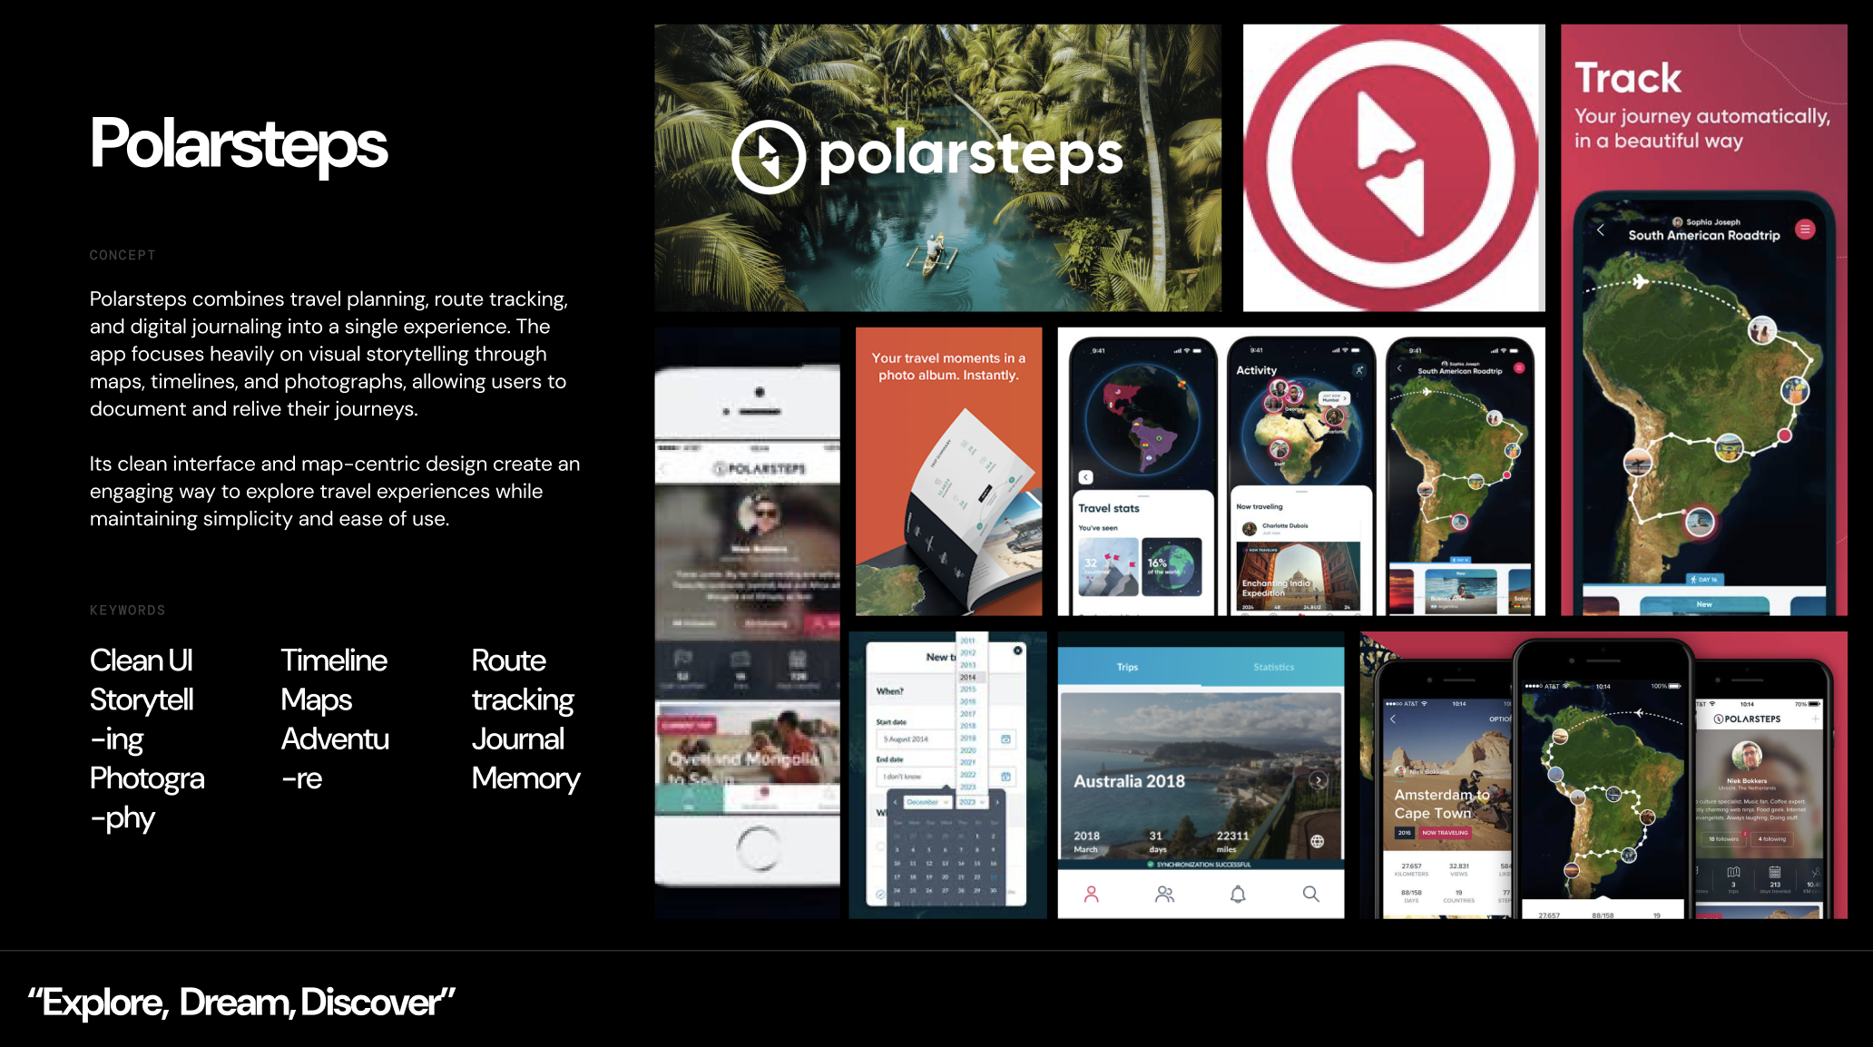
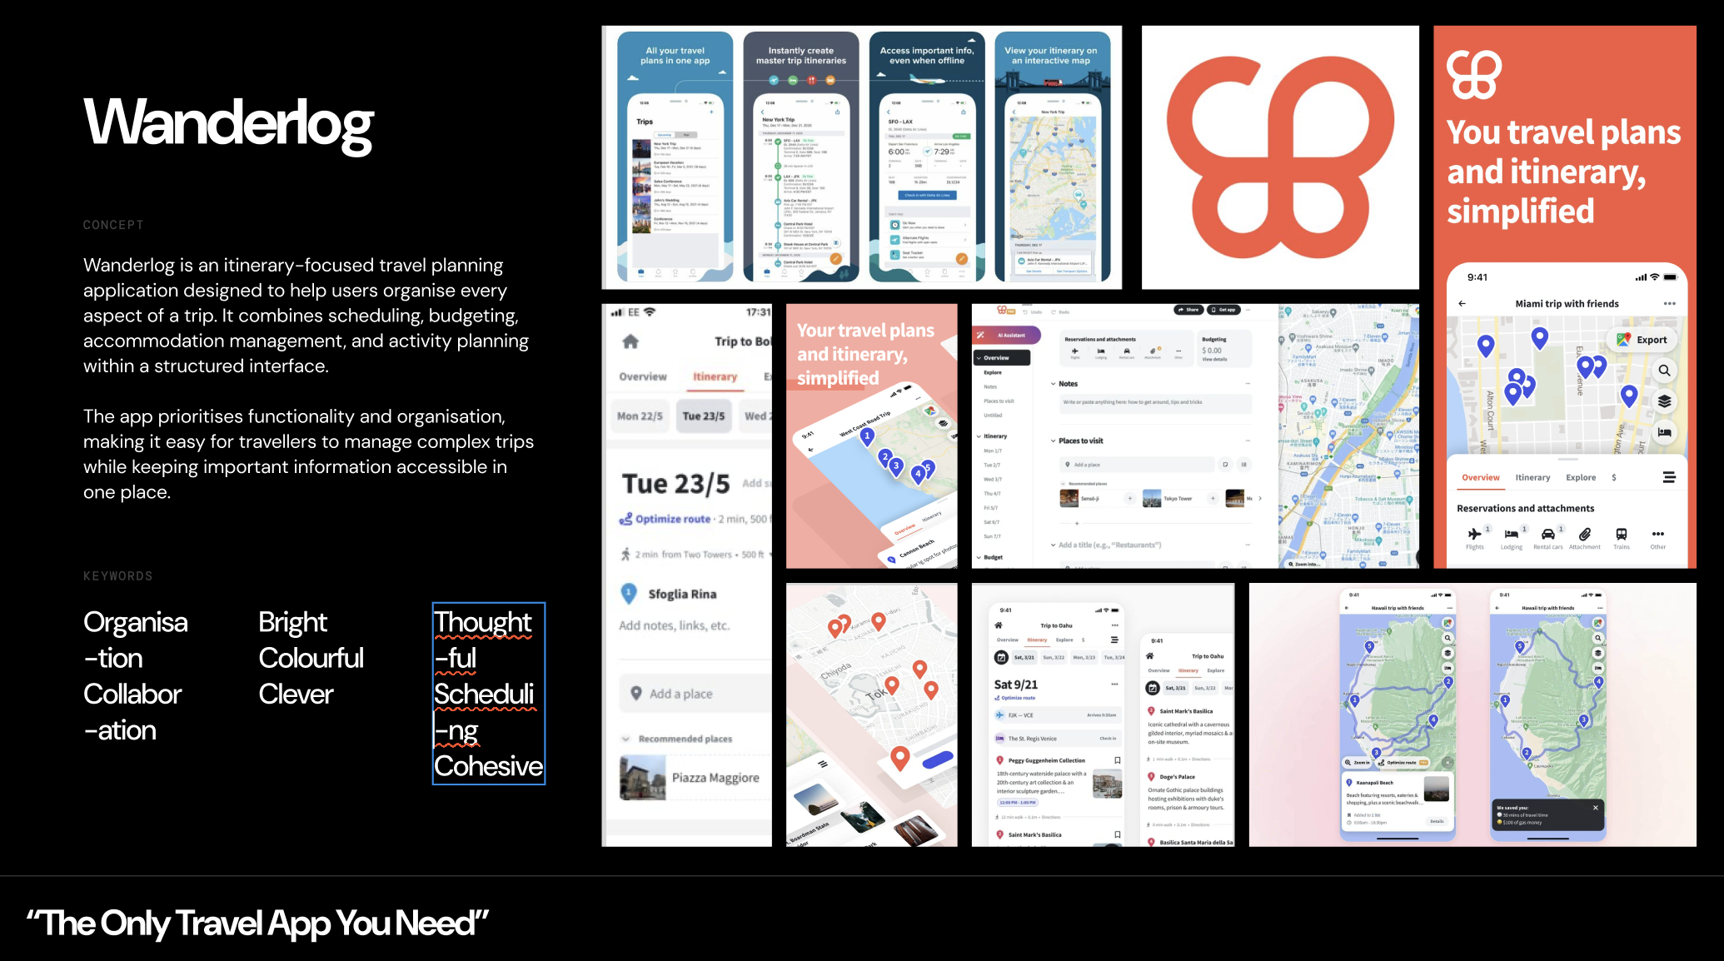
Moodboard + Visual Keywords

Slide 11

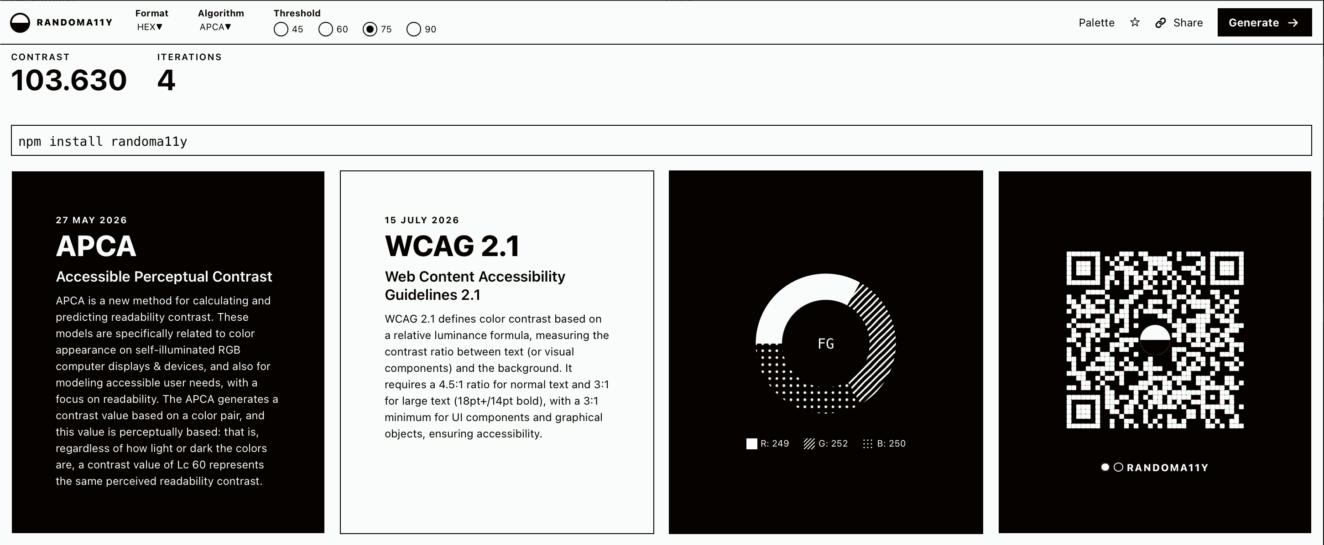
Colour Palette + Typography
Outfit was chosen due to its high readability and its geometric appearance, for a more modern interface.
The neutral palette prevents visual overload and allows destination imagery to become the primary source of colour and inspiration.

Slide 12
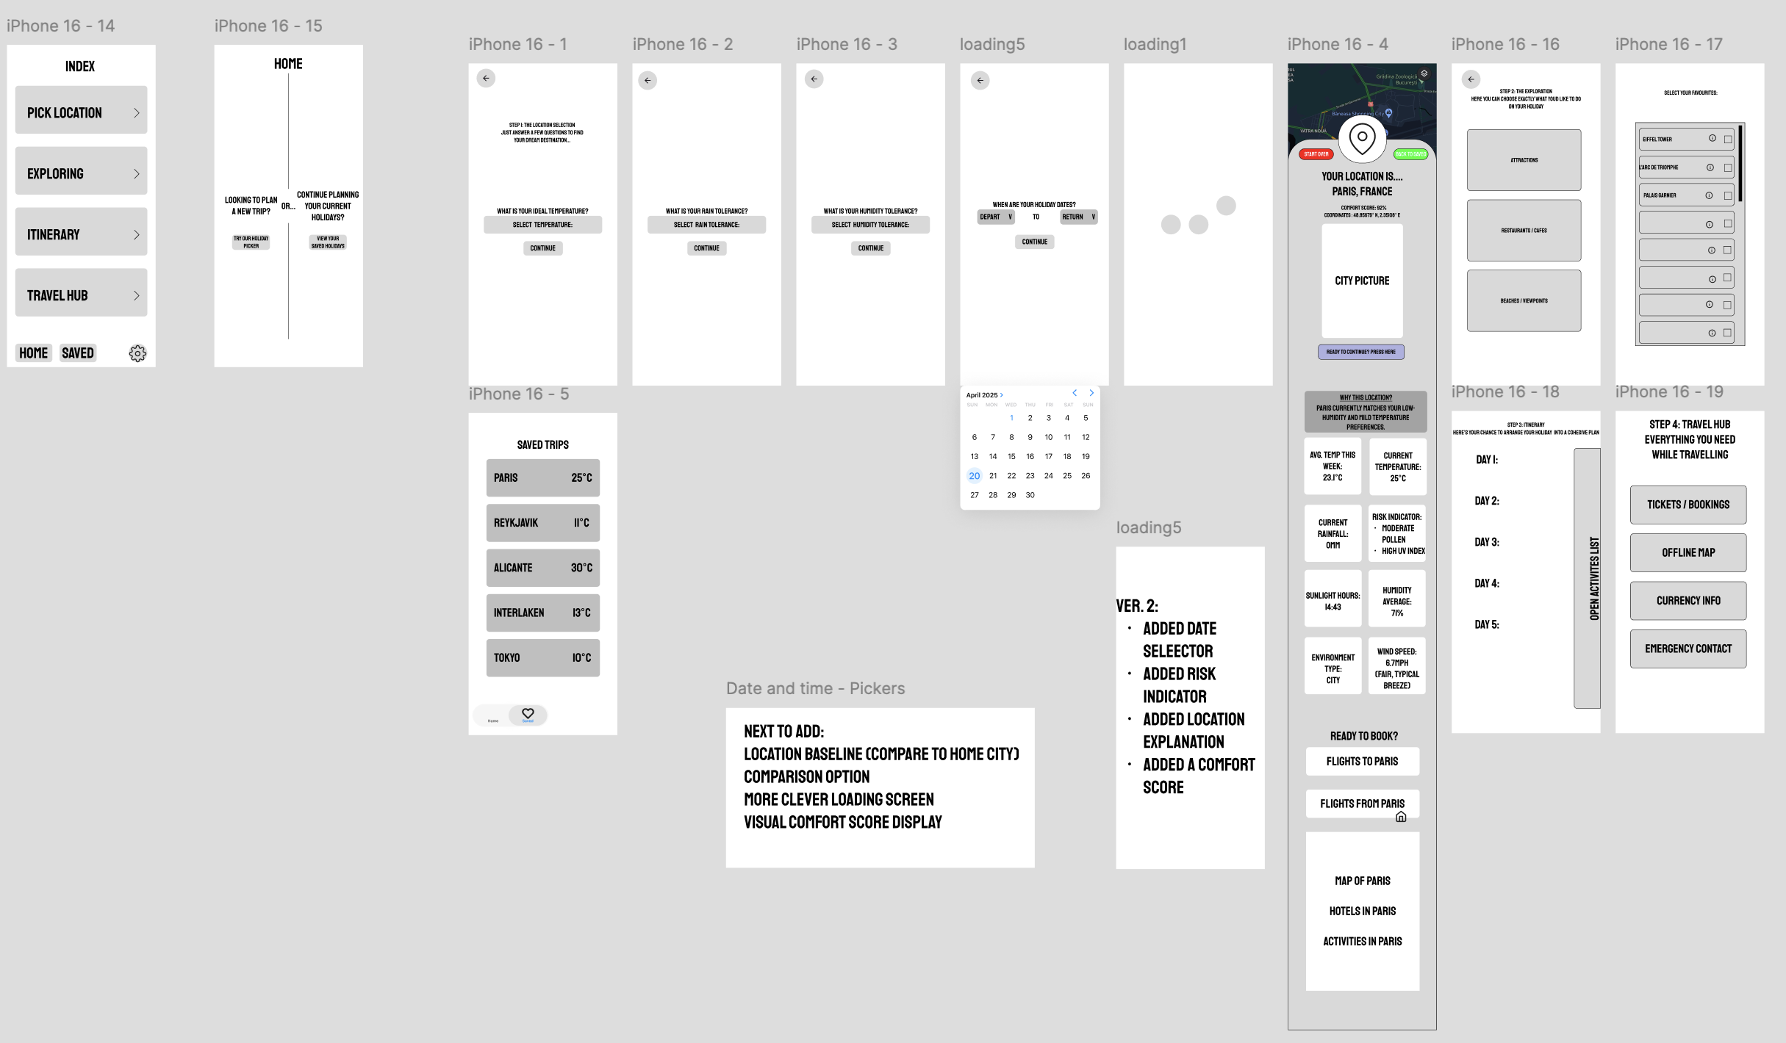
Low Fidelity Wireframe

Slide 13
Code Development

Slide 14
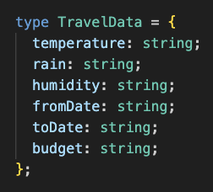
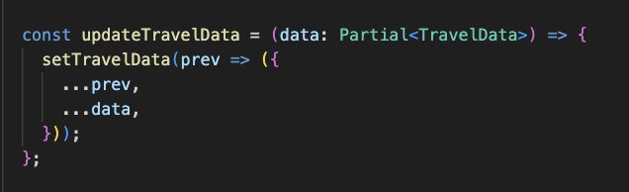
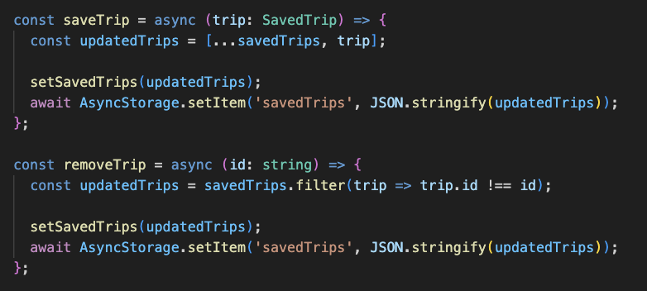
React Context
To allow data to be shared across multiple screens, I created a React Context named TravelContext to stores user preferences such as temperature, rainfall, humidity, travel dates and budget. This would allow information entered on one screen to be accessed by subsequent screens without manually passing props between components. The context also manages saved trips, enabling users to store and retrieve destinations using React Native’s AsyncStorage.

Slide 15
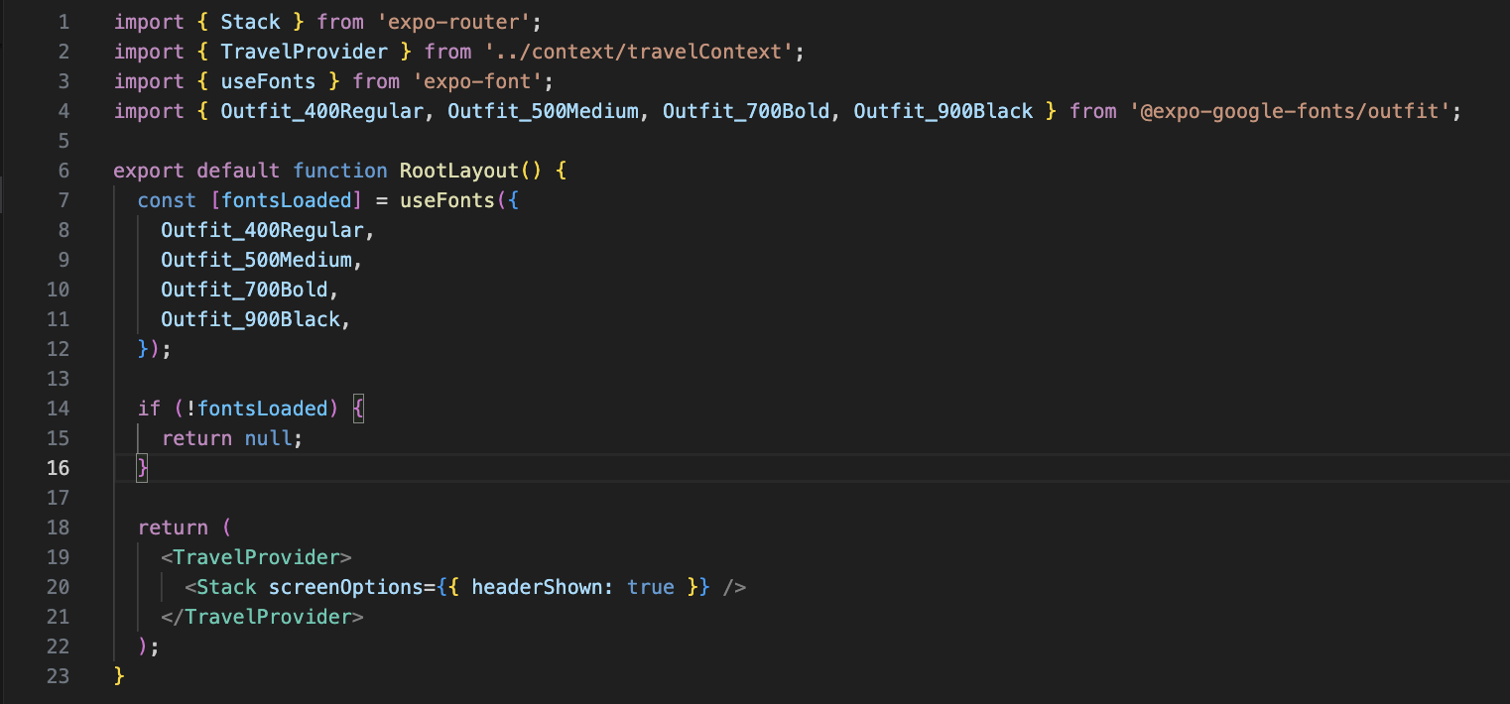
Root Layout Page
The RootLayout component acts as the entry point of the app. It loads the Outfit font family to for a consistent visual style, wraps all screens inside the Travel Context Provider so that user preferences can be shared across the app, and configures the Stack Navigator used for screen-to-screen navigation. This structure creates a centralised foundation for both state management and navigation throughout the travel planner.

Slide 16
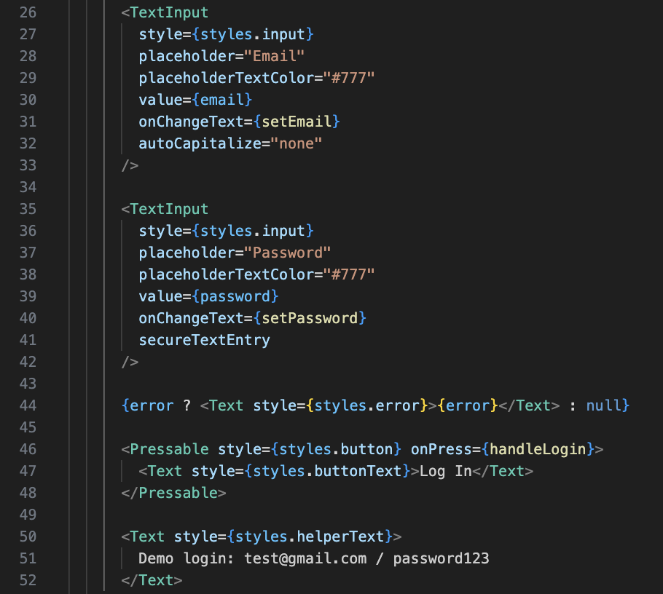
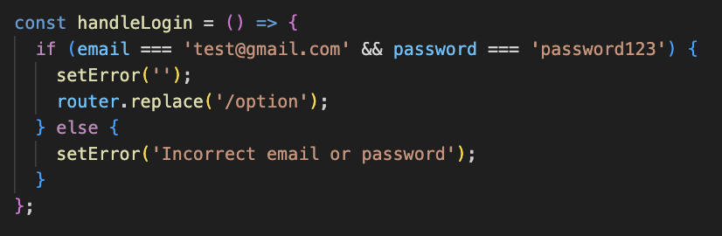
Login Screen
The login screen uses two text input fields to collect an email address and password. A validation function compares the user’s input against predefined credentials and either displays an error message or redirects the user to the main application. This approach simulates a real authentication flow without requiring a backend database, making it suitable for a prototype application. Once entered correctly it prompts users to the option screen, where they can choose whether to create a new Trip or view the pre-existing trips.

Slide 17
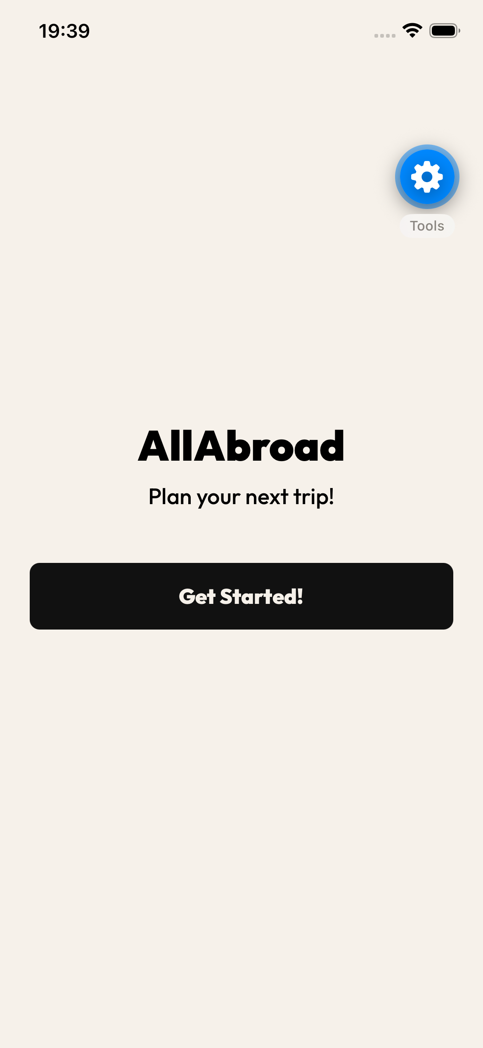
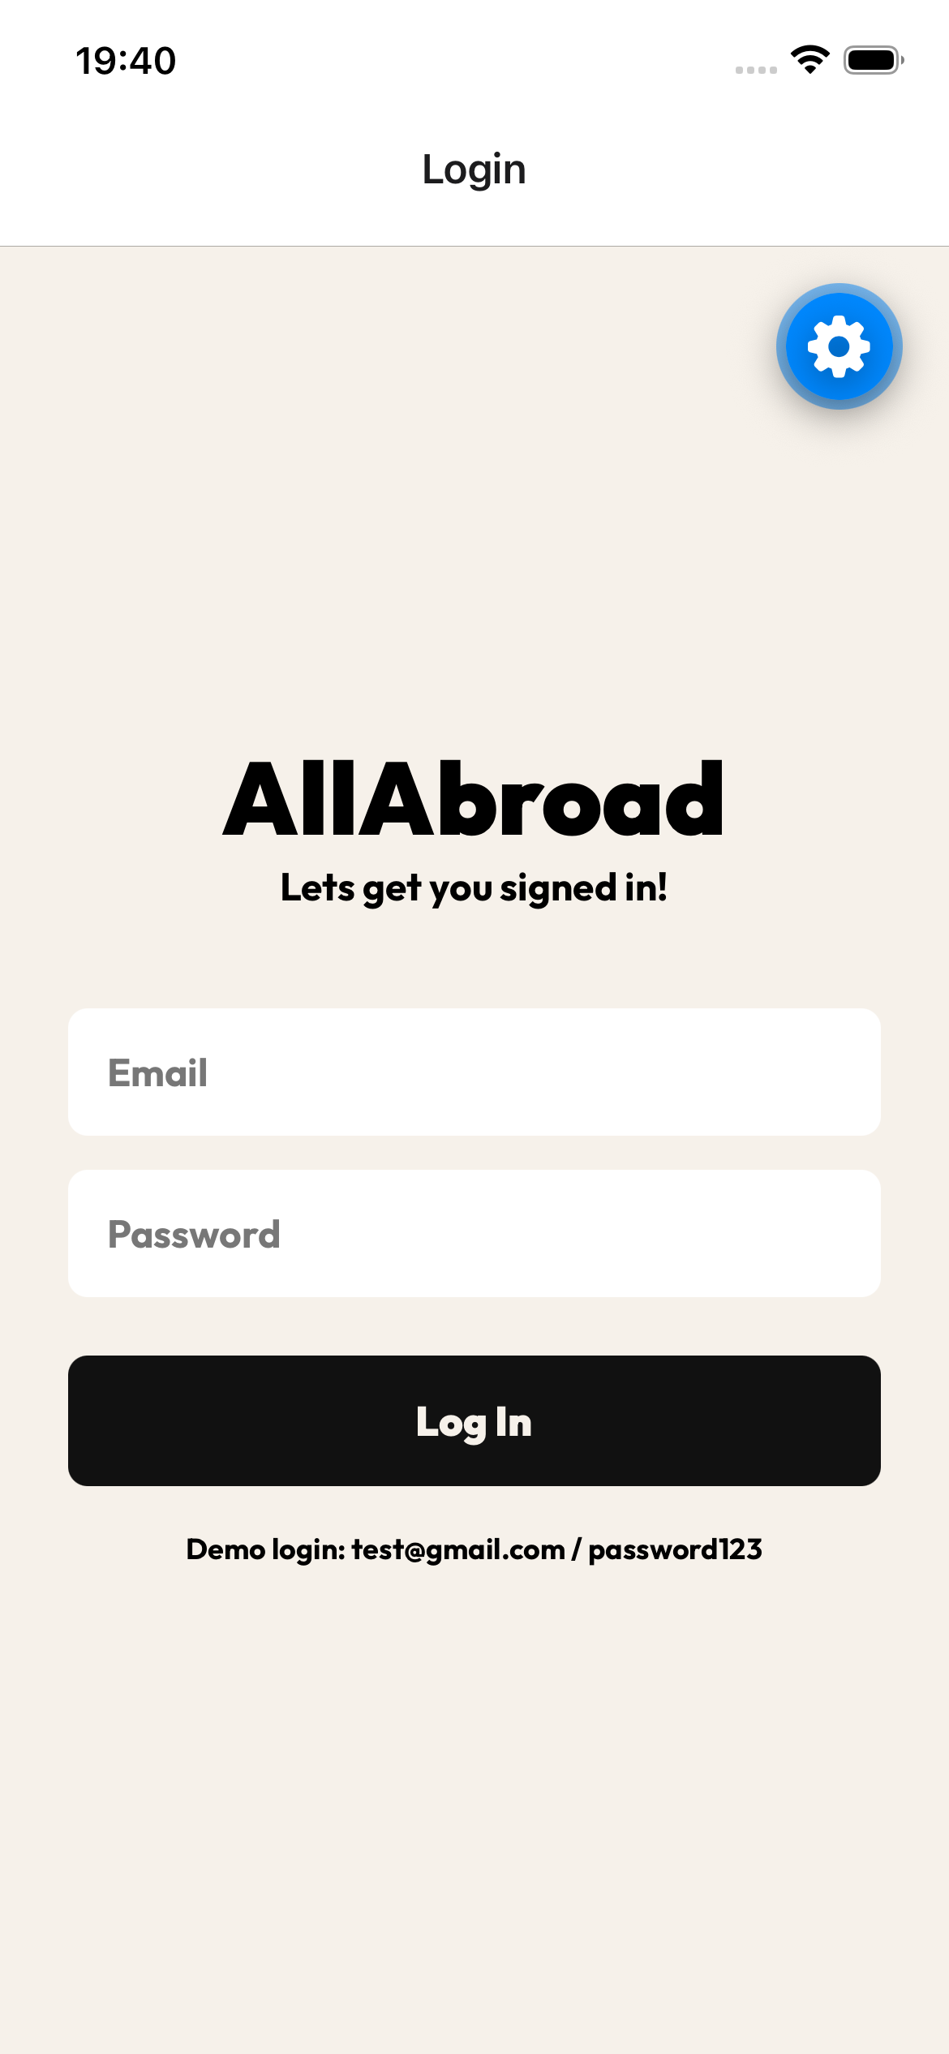
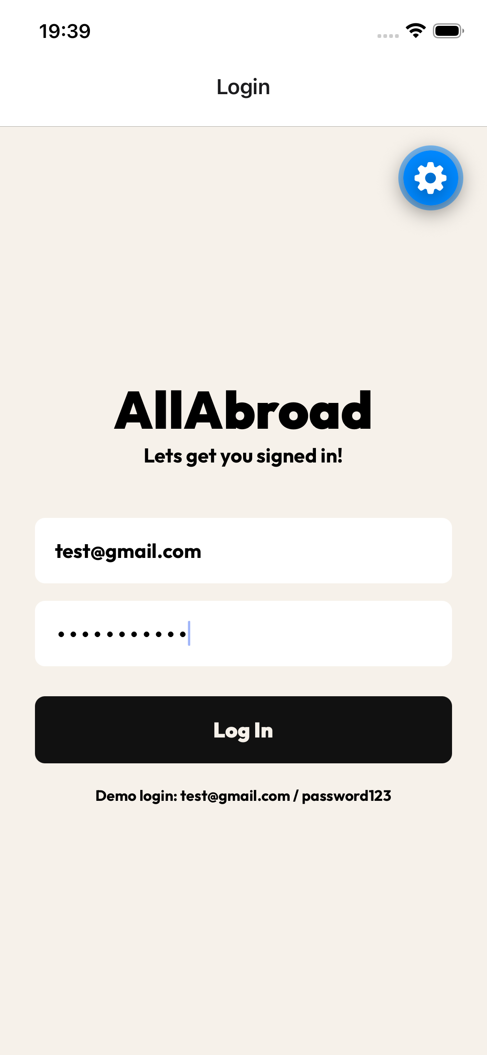
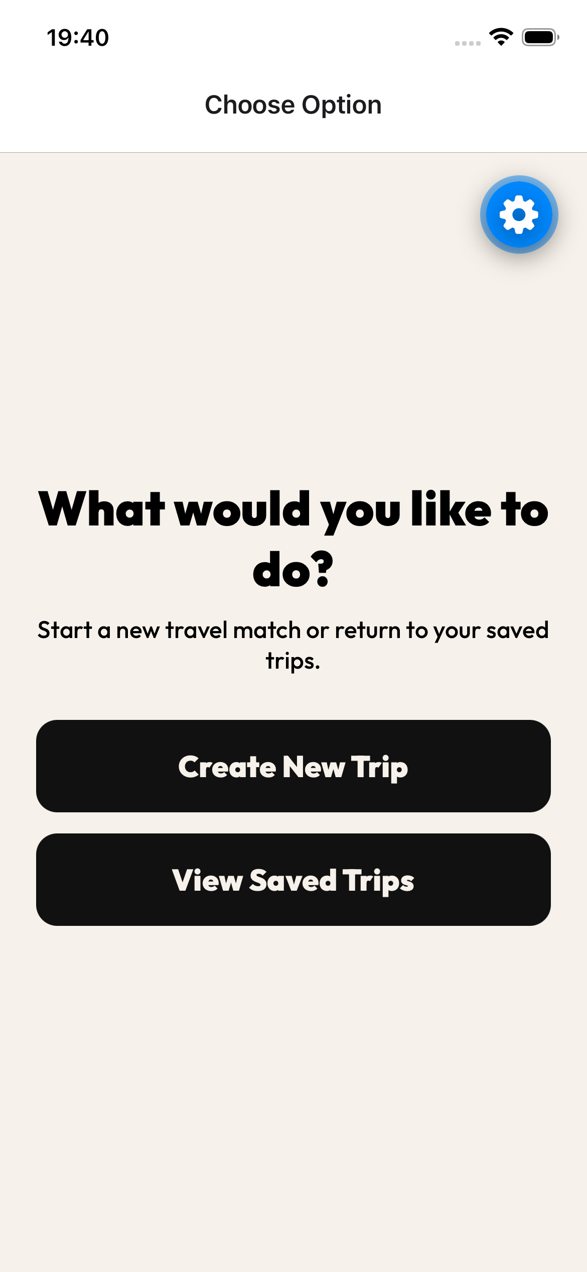
Home Screen + Sign In Flow
Home Screen
Sign-in page
Filled in sign-in page
Option screen once signed in

Slide 18

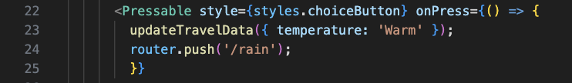
Questionnaire
The Temperature Preference screen is the first stage of the destination selection questionnaire. Users are presented with five climate options: Hot, Warm, Mild, Cold and Freezing. When an option is selected, the choice is stored in the application’s Travel Context using the updateTravelData() function. This allows the preference to persist across multiple screens and be used later when filtering destinations. After the selection is saved, the user is automatically navigated to the Rain Preference screen to continue the questionnaire.

Slide 19
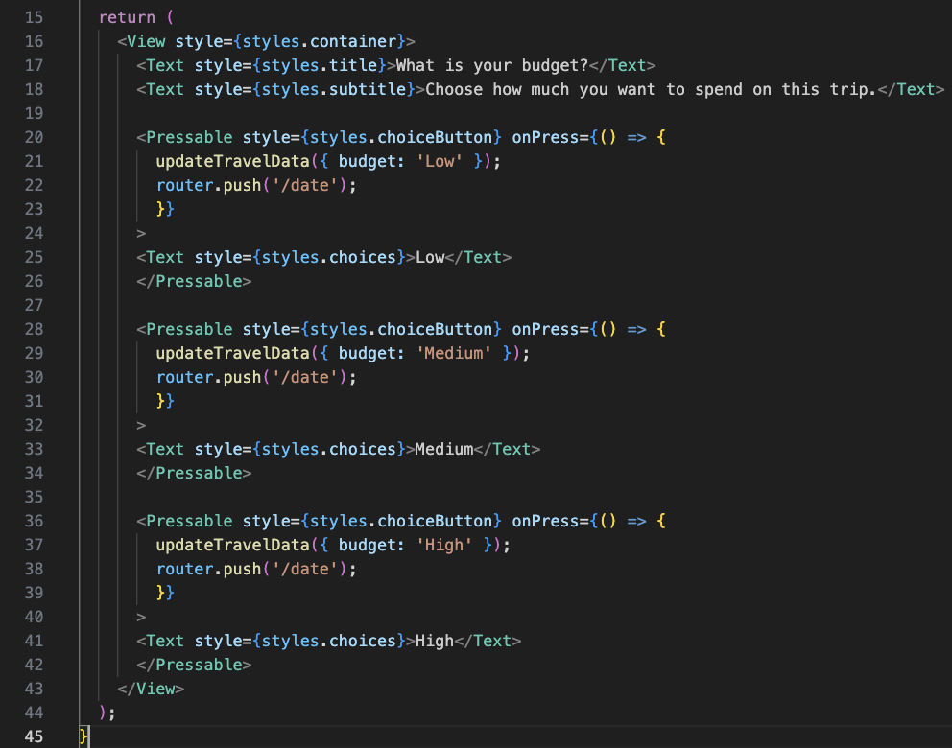
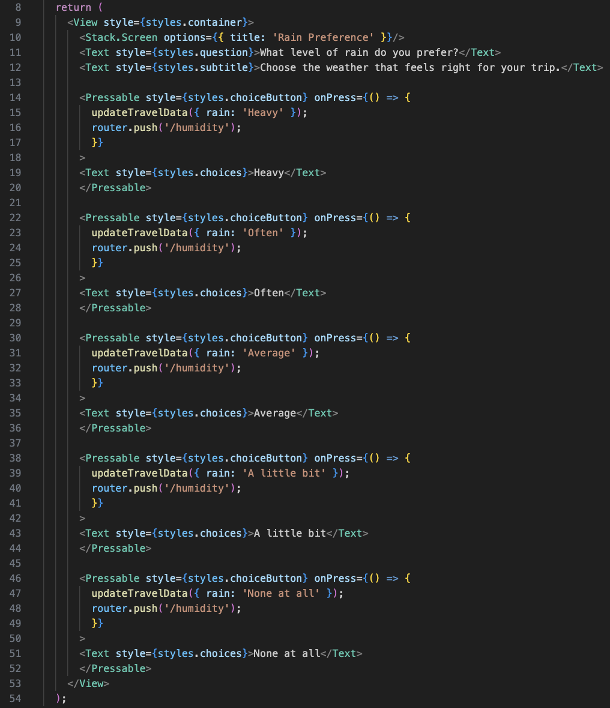
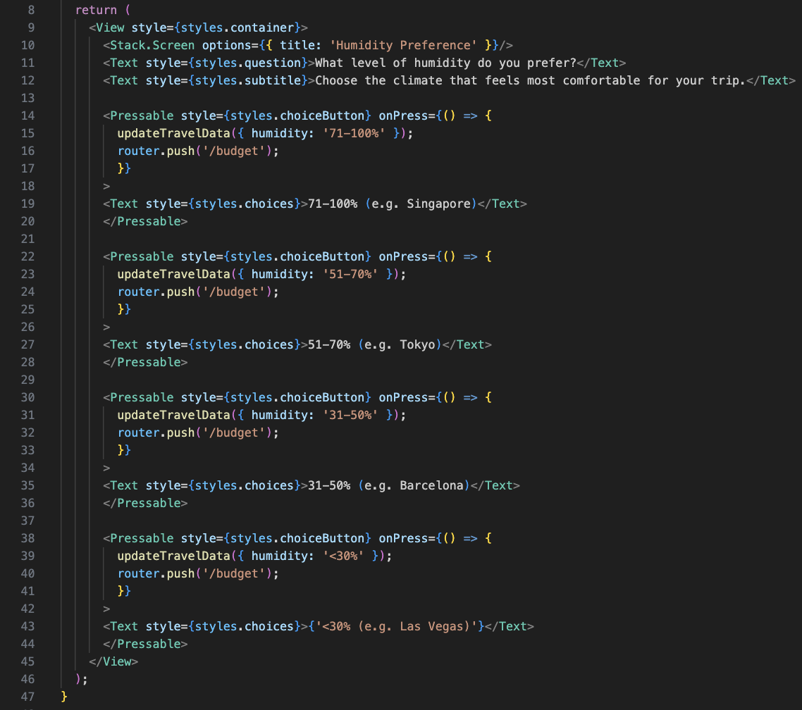
Questionnaire
Budget Question Screen
Rain Preference Question Screen
Humidity Preference Question Screen

Slide 20
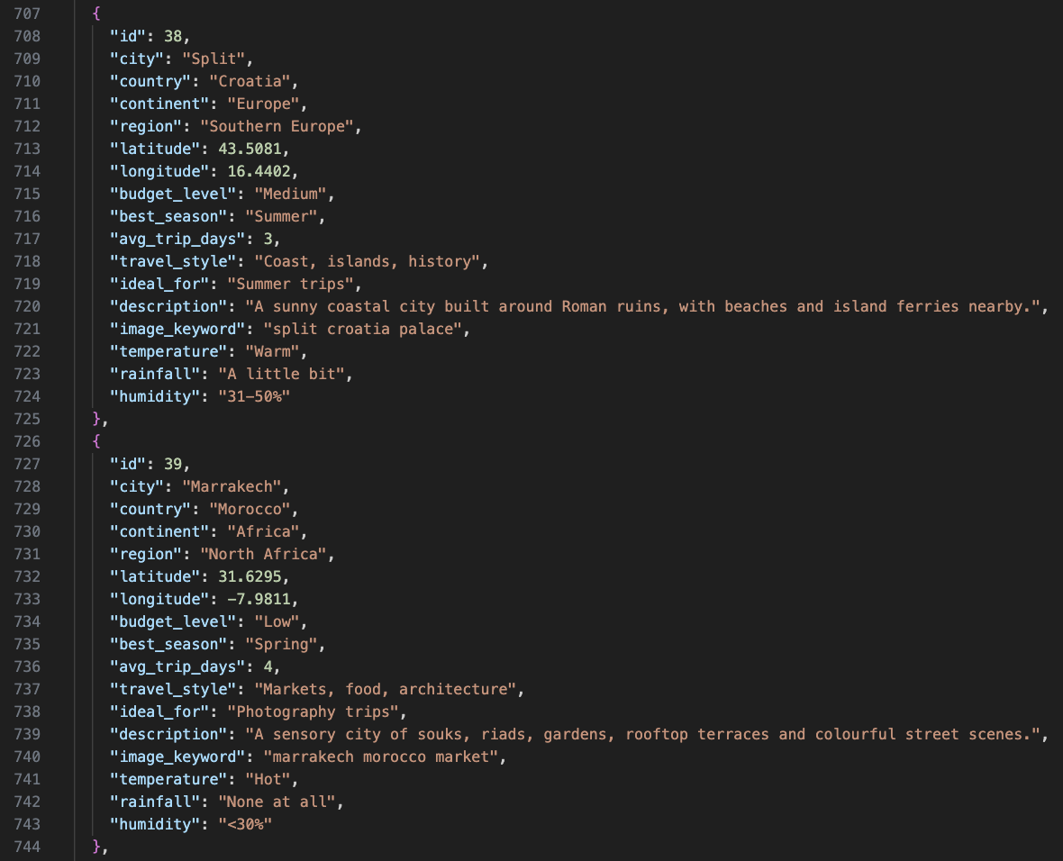
Dataset
I created a JSON dataset for the travel recommendation system, which contained destinations from all over the world with attributes such as location, budget level and climate information. Each city was categorised using simplified temperature, rainfall and humidity values that directly correspond to the options presented in the user questionnaire, so the app could filter destinations based on user preferences and generate personalised travel recommendations. Using a local dataset rather than an external API improved performance and provided full control over the quality and consistency of destination information used throughout the application.

Slide 21
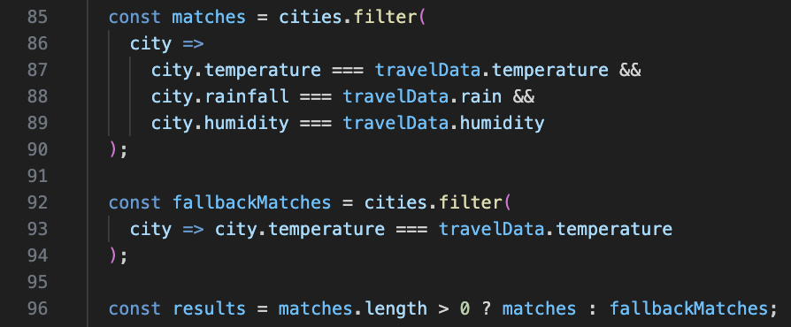
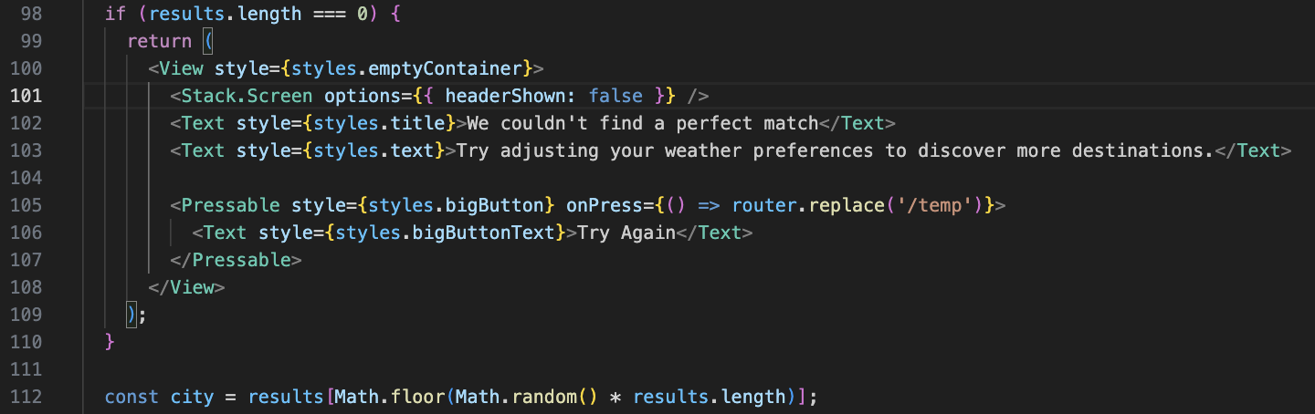
Filtering Logic + Results Page
The recommendation system uses a filtering algorithm to compare the user’s questionnaire responses against the destination dataset. The application filters cities based on three weather-related criteria: temperature, rainfall and humidity. If an exact match is found, those destinations are returned as recommendations. To improve usability, a fallback system was also implemented which filters destinations using only the temperature preference if no exact matches exist. This ensures that users always receive a destination recommendation while still prioritising locations that closely match their preferences.

Slide 22
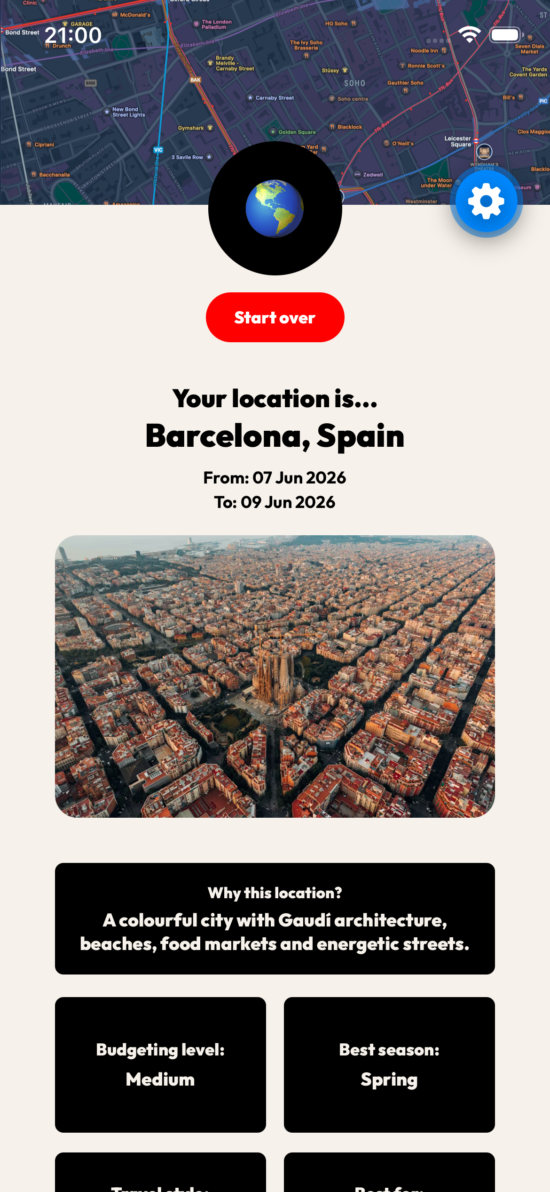
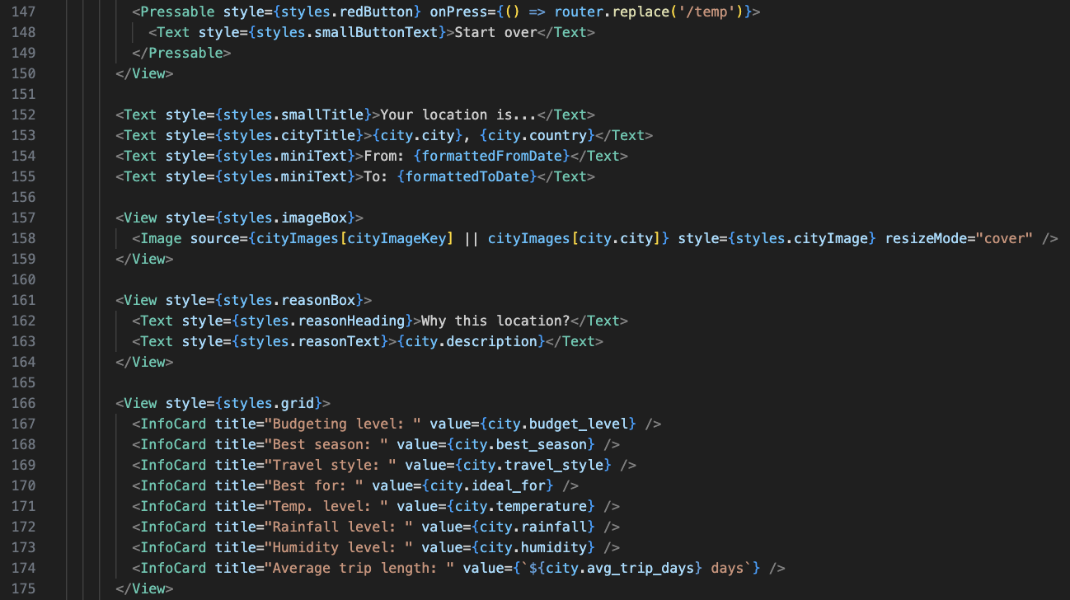
Results Page
The Results Page displays the final destination recommendation generated from the user’s responses. It takes the city data and presents it in a visually engaging format, including the destination name, country and a short explanation of why the location was recommended. Additional information is organised into information cards, showing details such as budget level, best season and average trip length. The page also includes a “Start over” button, allowing users to restart the questionnaire, and a save trip option so the chosen destination can be stored and viewed later in the Saved Trips section.

Slide 23
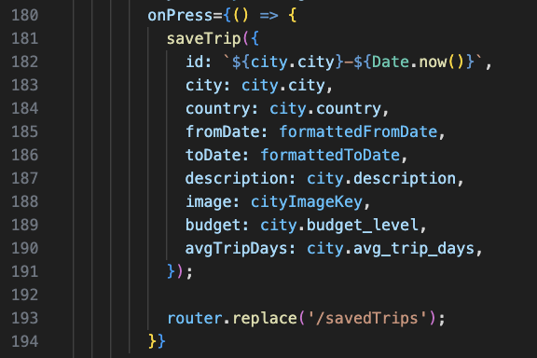

Save Trip Feature
The Save Trip feature allows users to store recommended destinations for future reference. When the save button is pressed, a trip object containing information such as the city, country, travel dates, description, image, budget level and average trip duration is created and passed to the saveTrip() function. This function adds the trip to the existing saved trips array and stores the updated data using React Native’s AsyncStorage, ensuring that trips remain available even after the application is closed. Once the trip has been saved successfully, the user is redirected to the Saved Trips page, providing a seamless way to revisit and manage previously selected destinations.

Slide 24
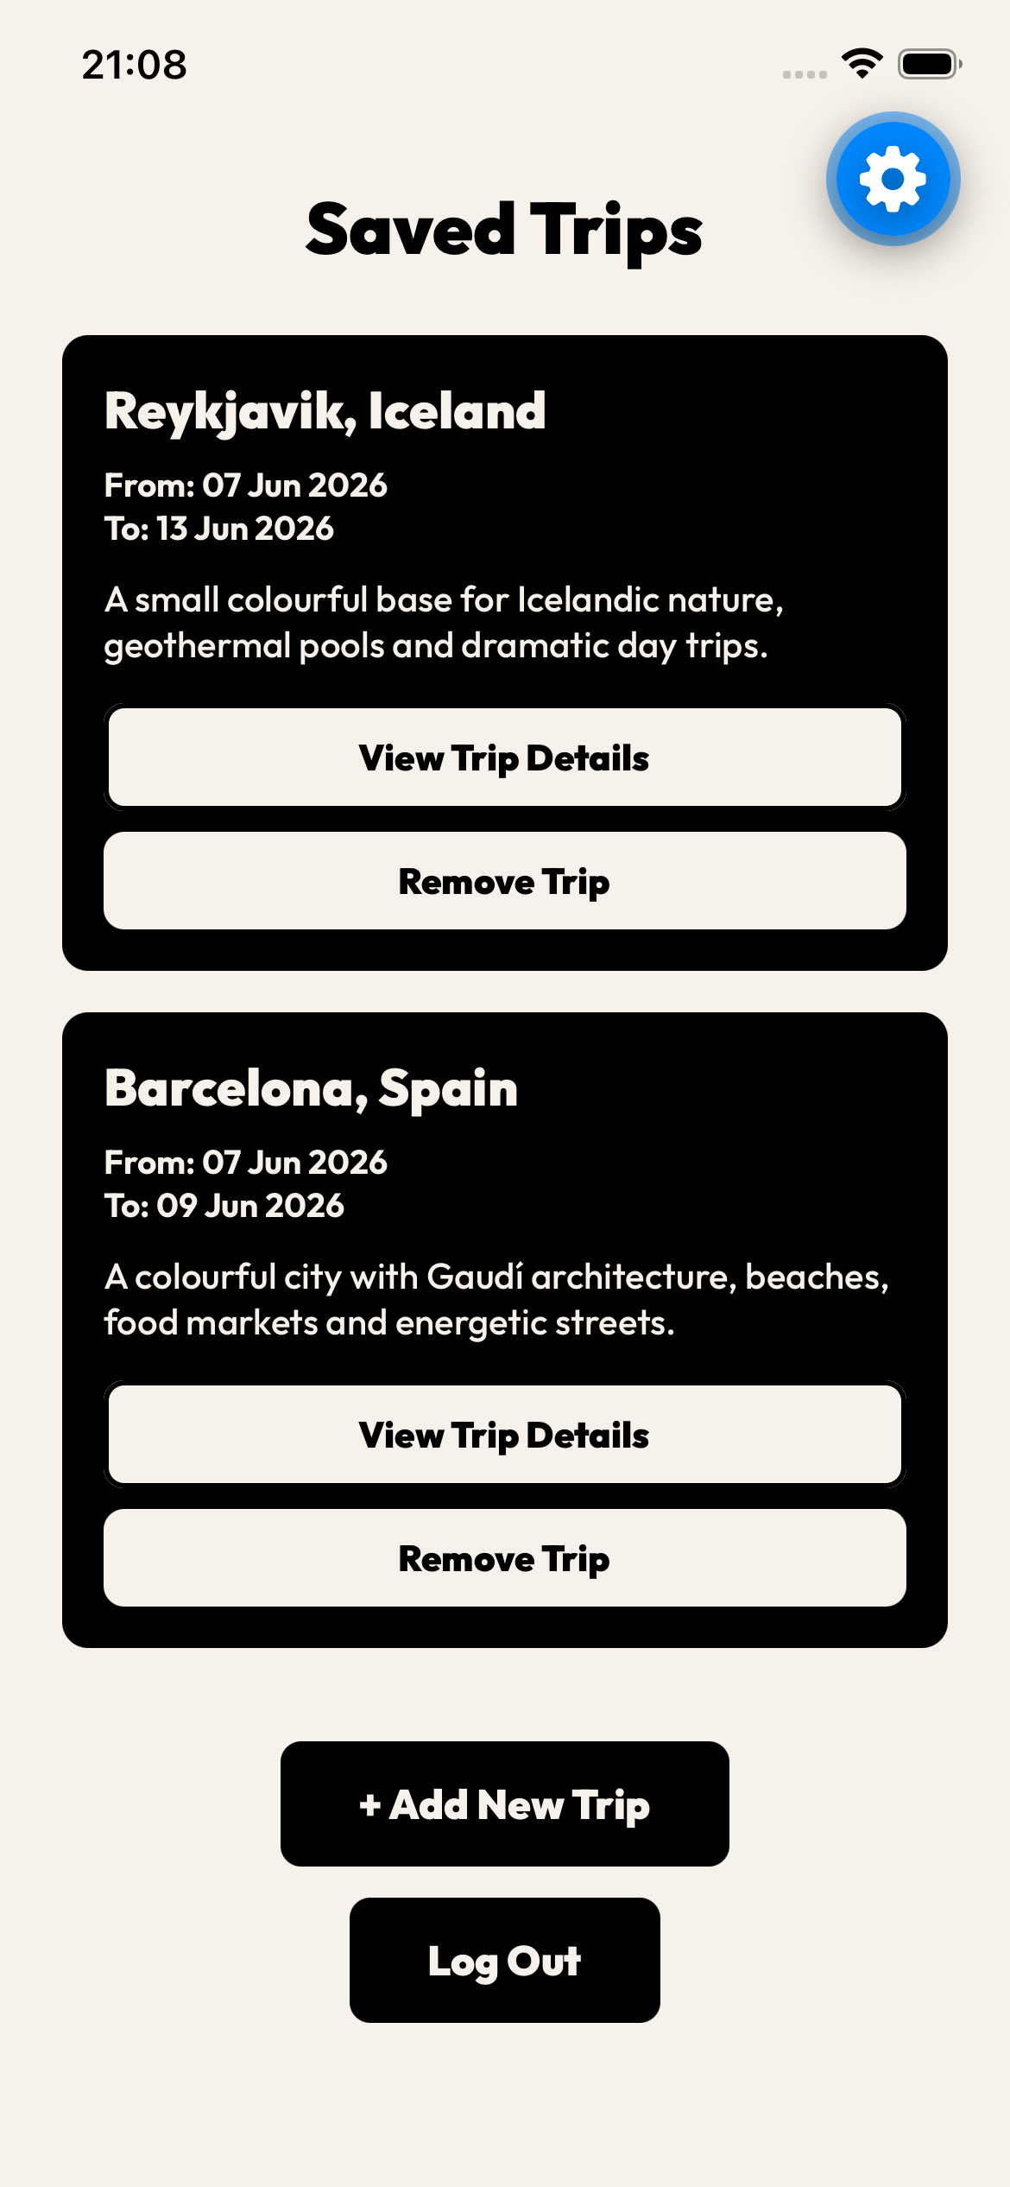
Saved Trips Page
The Saved Trips page acts as a personal destination library where users can access and manage trips they have previously saved. Each trip is displayed as a card containing key information, including the destination name, travel dates and a short description, allowing users to quickly review their selections. Users can choose to view additional information through the View Trip Details button or remove unwanted destinations using the Remove Trip button. The page also includes an Add New Trip button, which returns the user to the questionnaire to discover another destination, and a Log Out button to exit the application. This feature improves the overall user experience by providing persistent storage and easy access to previously generated travel recommendations.

Slide 25
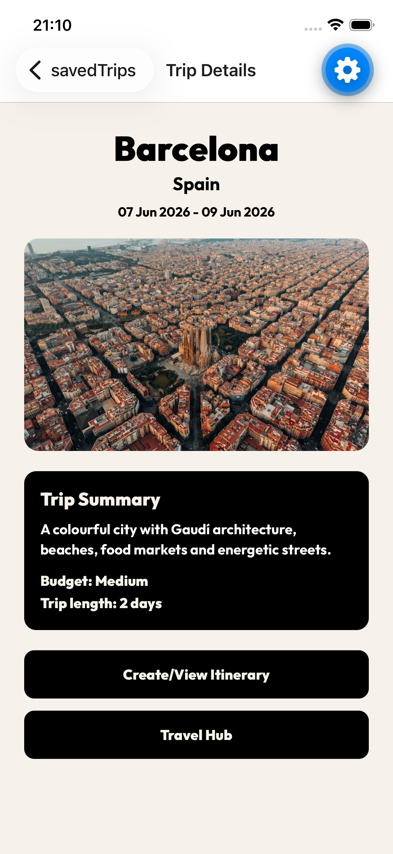
Trip Details Page
The Trip Details page acts as the central hub for a saved trip. It displays key destination information including the city name, travel dates, featured image, trip summary, budget level, and trip length. The page was designed to provide users with a quick overview of their selected destination while also serving as a navigation point to additional features. Users can access the itinerary planner through the “Create/View Itinerary” button or view travel information and resources through the “Travel Hub” section.

Slide 26
Testing

Slide 27
User Testing
Tester | Task | Issue(s) | Changes
Tester 1 | Create & Save Trip | Could not easily identify how to restart the questionnaire after receiving a destination. | Highlighted button in red
Tester 2 | View Saved Trip | Found navigation straightforward and destination recommendations easy to understand. | N/A
Tester 3 | Try again | Expected Try Again to restart the questionnaire rather than generate another destination. | Updated app flow and route

Slide 28
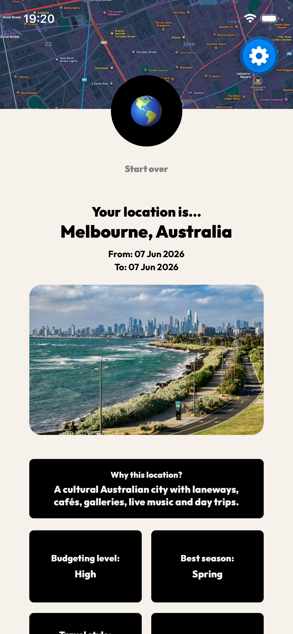
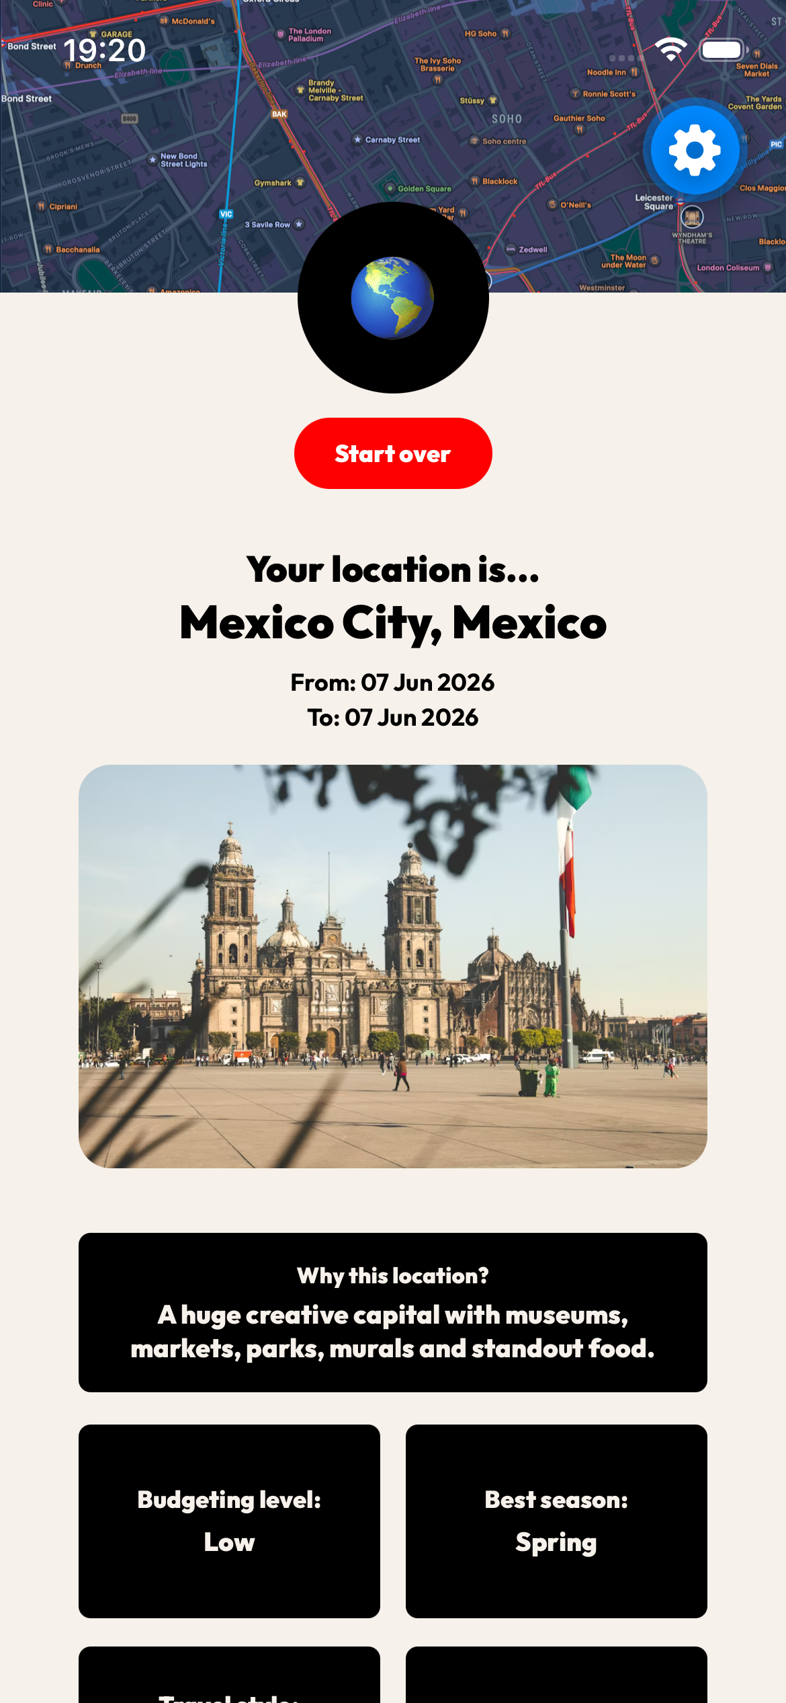
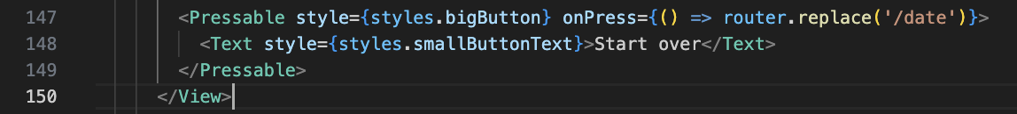
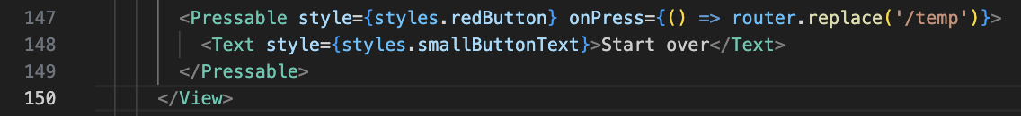
User Testing
Issue 1:
Issue 3:
Before:
After:
Before:
After:

Slide 29
Reflection

Slide 30
Reflection
What Went Well:
Overall, I am satisfied with the final outcome of the AllAbroad app. The core functionality outlined during the planning stage was implemented well, including the destination questionnaire, recommendation system, trip saving functionality and trip management screens. I particularly enjoyed using React Context, as it allowed the users' travel preferences to be shared efficiently across multiple screens. The final user interface also fairly matched my original Figma designs.
What I learned:
This project significantly improved my understanding of React Native. Before this project, I had no experience building mobile apps. Through developing AllAbroad, I gained practical experience using Expo Router, React Context, AsyncStorage and JSON-based datasets. I also developed a stronger understanding of mobile-first design principles and how to structure applications around user needs rather than purely technical requirements.
Future Implementations:
If I were to continue developing the app, I would focus on expanding the recommendation system and travel planning features. Currently, destinations are selected from a local dataset, but future versions could integrate live APIs to provide real-time flight prices, hotel recommendations and weather forecasts. I would also like to introduce AI-powered destination suggestions, collaborative trip planning, ticket storage and cloud-based user accounts. These additions would transform the application from a prototype into a more comprehensive travel planning platform.

